Slide 1

Username:
Password:
Forget Password
Don’t have any account? Click here.
Login

Slide 2

Registration
Does not contain any numeric value.
Name:
Email:
Contact number must be 11 digits.
Contact Number:
Address:
Pet Category:
Enter Password:
Agree to the terms and conditions.
Aditya Das
dasaditya99678@gmail.com
01785946975
Bashudhara Residential Area, Dhaka
Cat, Dog
Should have at least one number.
Should have at least one uppercase and one lowercase character.
Should have at least one special symbol.
Should be between 6 to 20 characters long.
**********
?
Submit

Slide 3

Congratulations you are successfully registered!!!
Your Username: dasaditya0001
.

Slide 4
Username:
Password:
Forget Password
Don’t have any account? Click here.
dasaditya001
Login

Slide 5
Password Reset Process
Enter your valid email address:
Check your email for OTP.
.
dasaditya99678@gmail.com
Send

Slide 6
Give your OTP here
OTP is valid for 2 minutes. Didn’t get OTP?
Verify

Slide 7
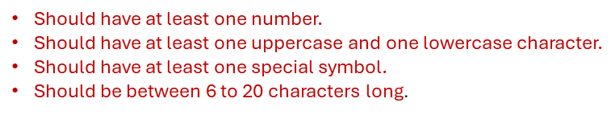
Reset Password
Enter New Password: ?
Password must me same.
Confirm Password:
.
**********
?
**********
Save

Slide 8





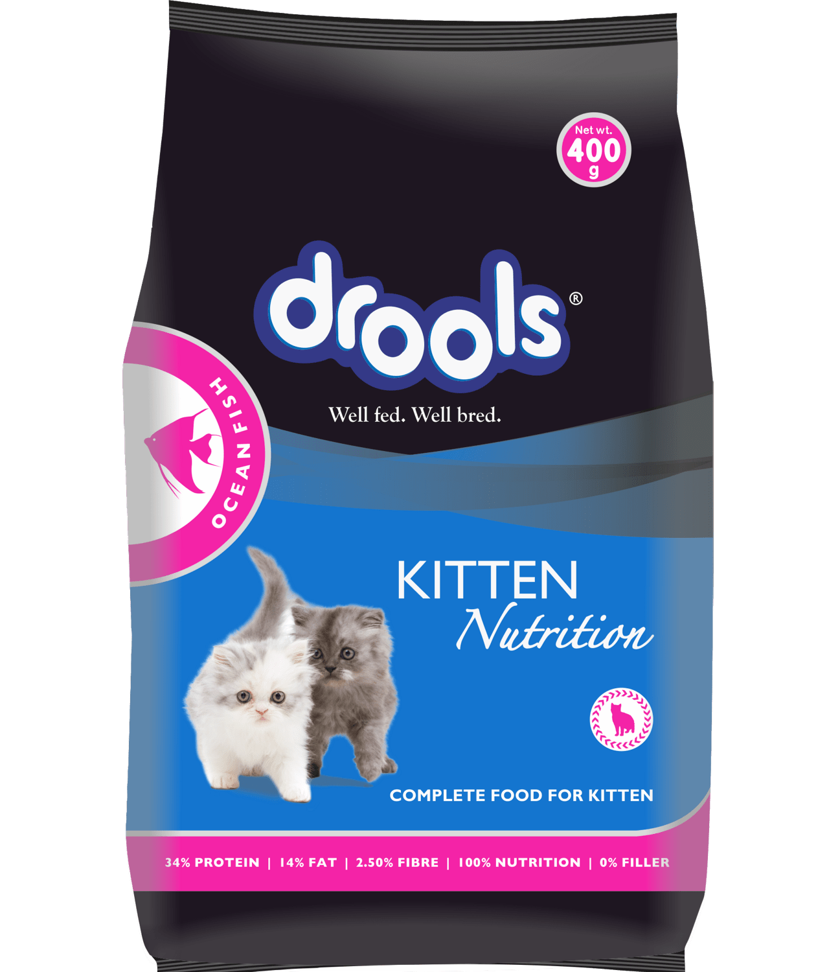

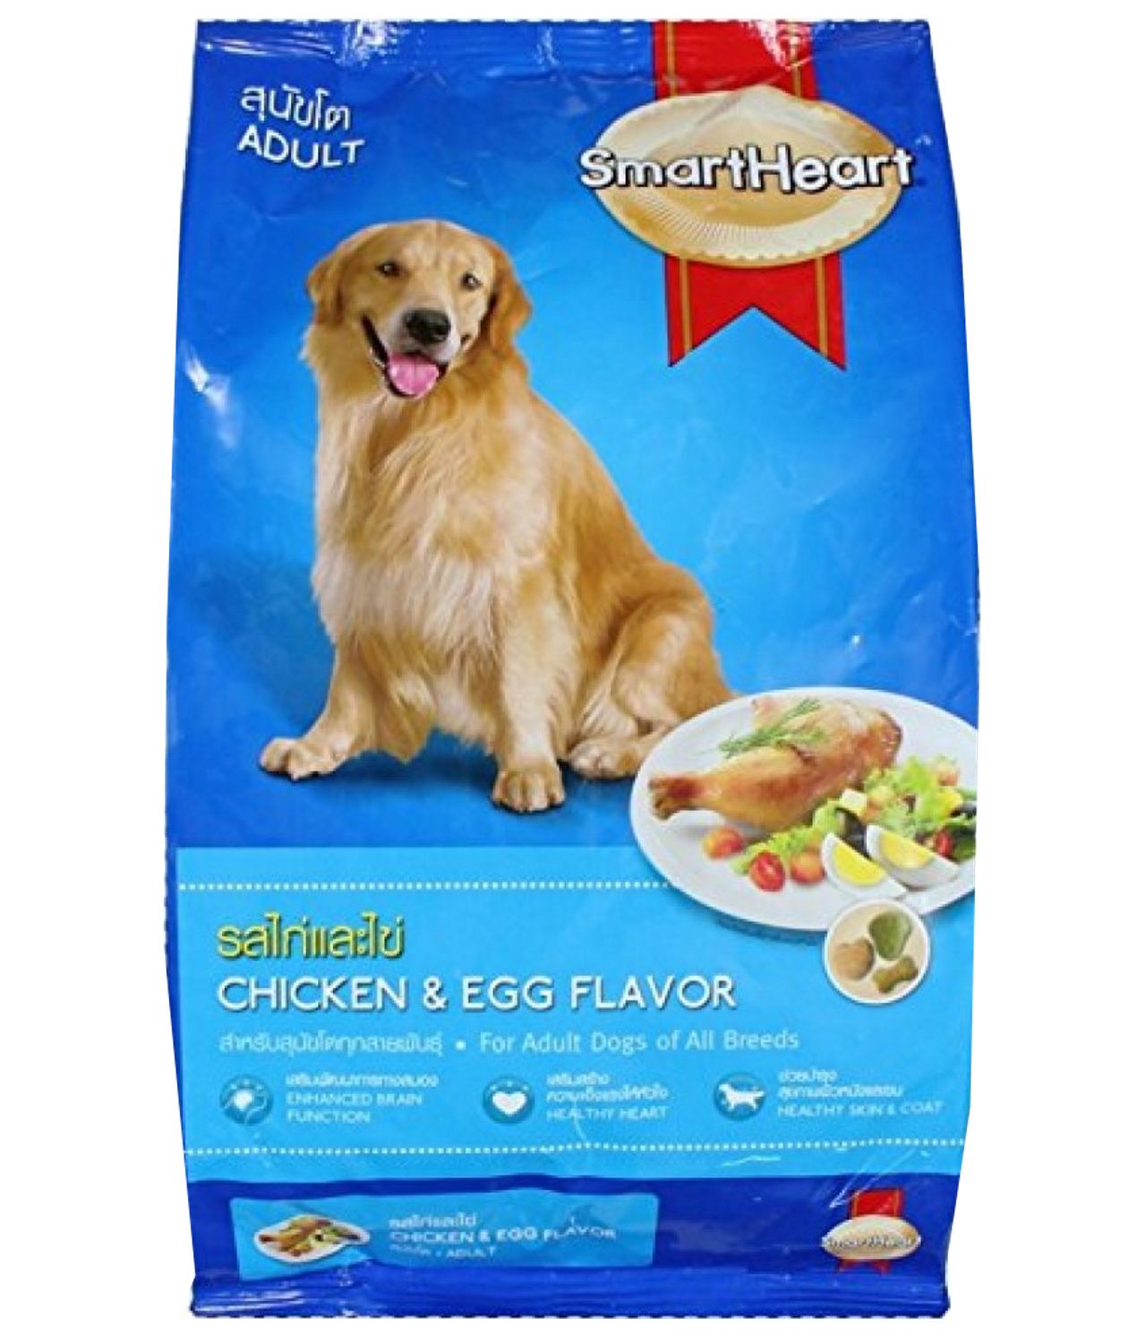
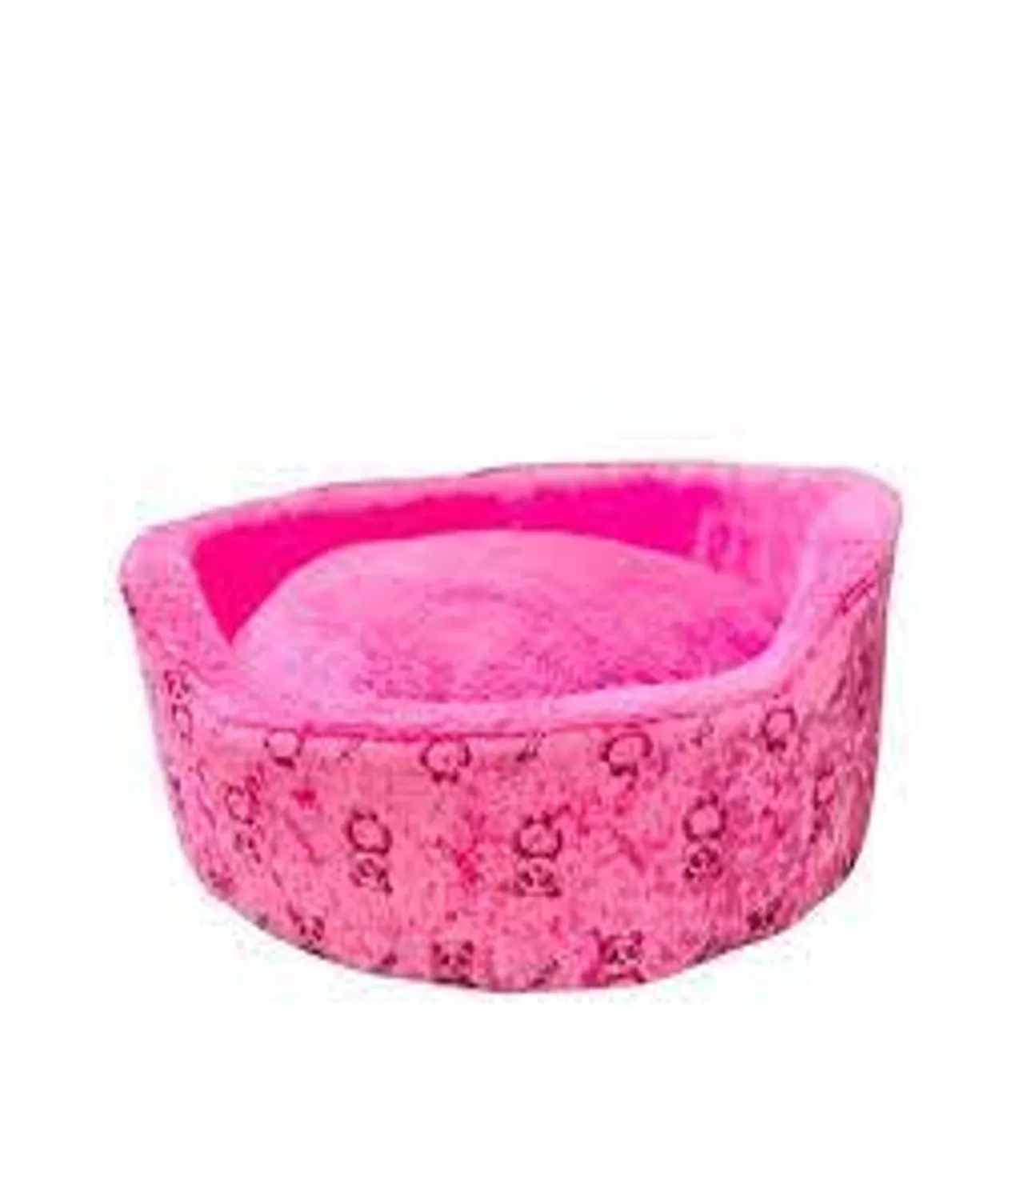
Delivery Charge Tk 40/- within Dhaka City.
Free Delivery within Dhaka City for Orders above Tk 1800/-
Search your product
My Account
Add to Cart
Helpline- 10360
Home
Shop
Service
About Us
Blog
Contact Us
Our Most Popular Products
Premium Cat Bed Foam Shape (Large)
Tk. 400 Tk. 380
Premium Cat food (800g)
Tk1400 Tk 1350
Helminticide-L Deworming Tablet (1 Strip)
Tk 100
SmartHeart Adult Dog Food Chicken And Egg (20Kg)
Tk 6420
Add to Cart
Add to Cart
Add to Cart
Add to Cart

Slide 9
Delivery Charge Tk 40/- within Dhaka City.
Free Delivery within Dhaka City for Orders above Tk 1800/-
Search your product
My Account
Add to Cart
Helpline- 10360
Home
Shop
Service
About Us
Blog
Contact Us
Food
Accessories
Medicine
Our Most Popular Products
Premium Cat Bed Foam Shape (Large)
Tk. 400 Tk. 380
Premium Cat food (800g)
Tk1400 Tk 1350
Helminticide-L Deworming Tablet (1 Strip)
Tk 100
SmartHeart Adult Dog Food Chicken And Egg (20Kg)
Tk 6420
Add to Cart
Add to Cart
Add to Cart
Add to Cart

Slide 10
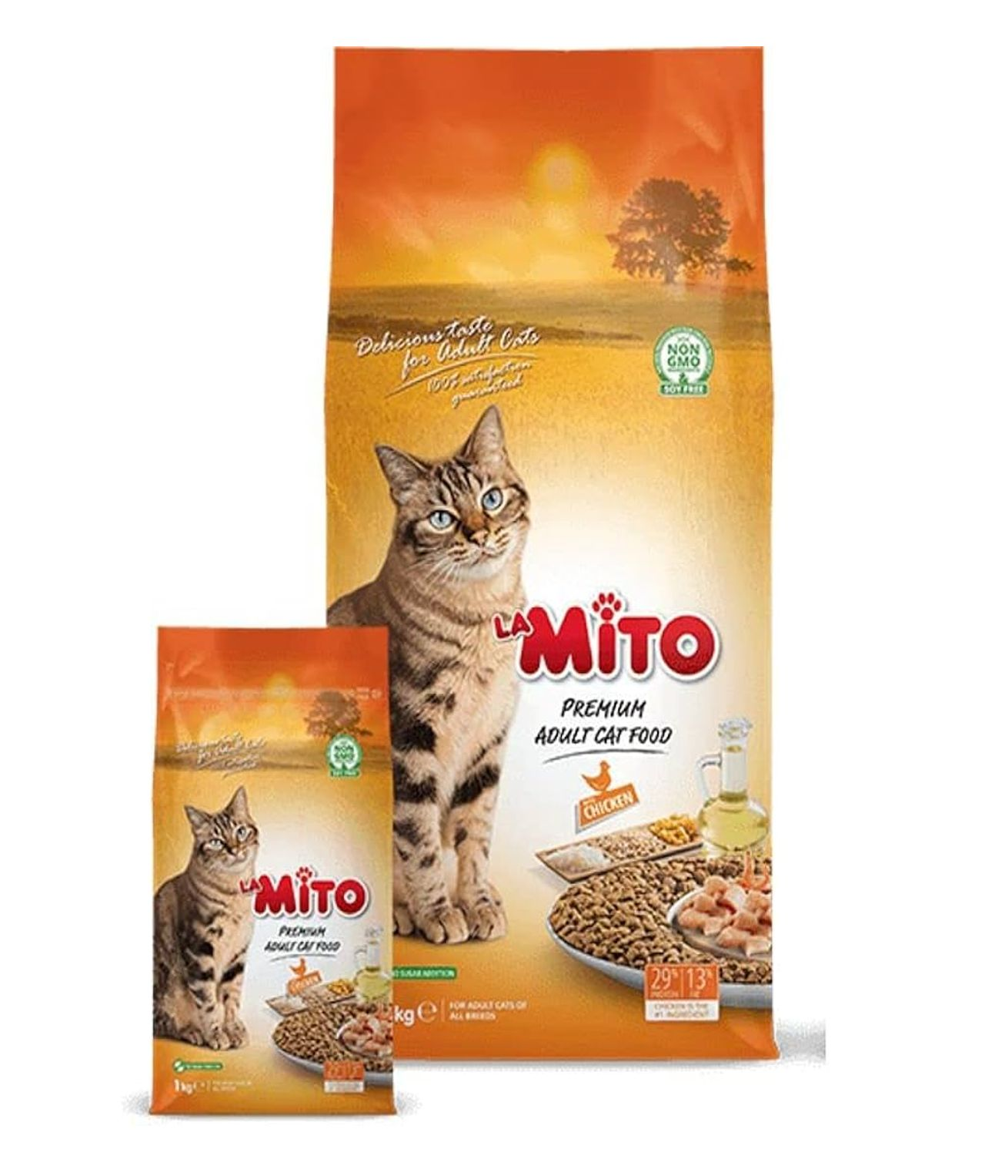
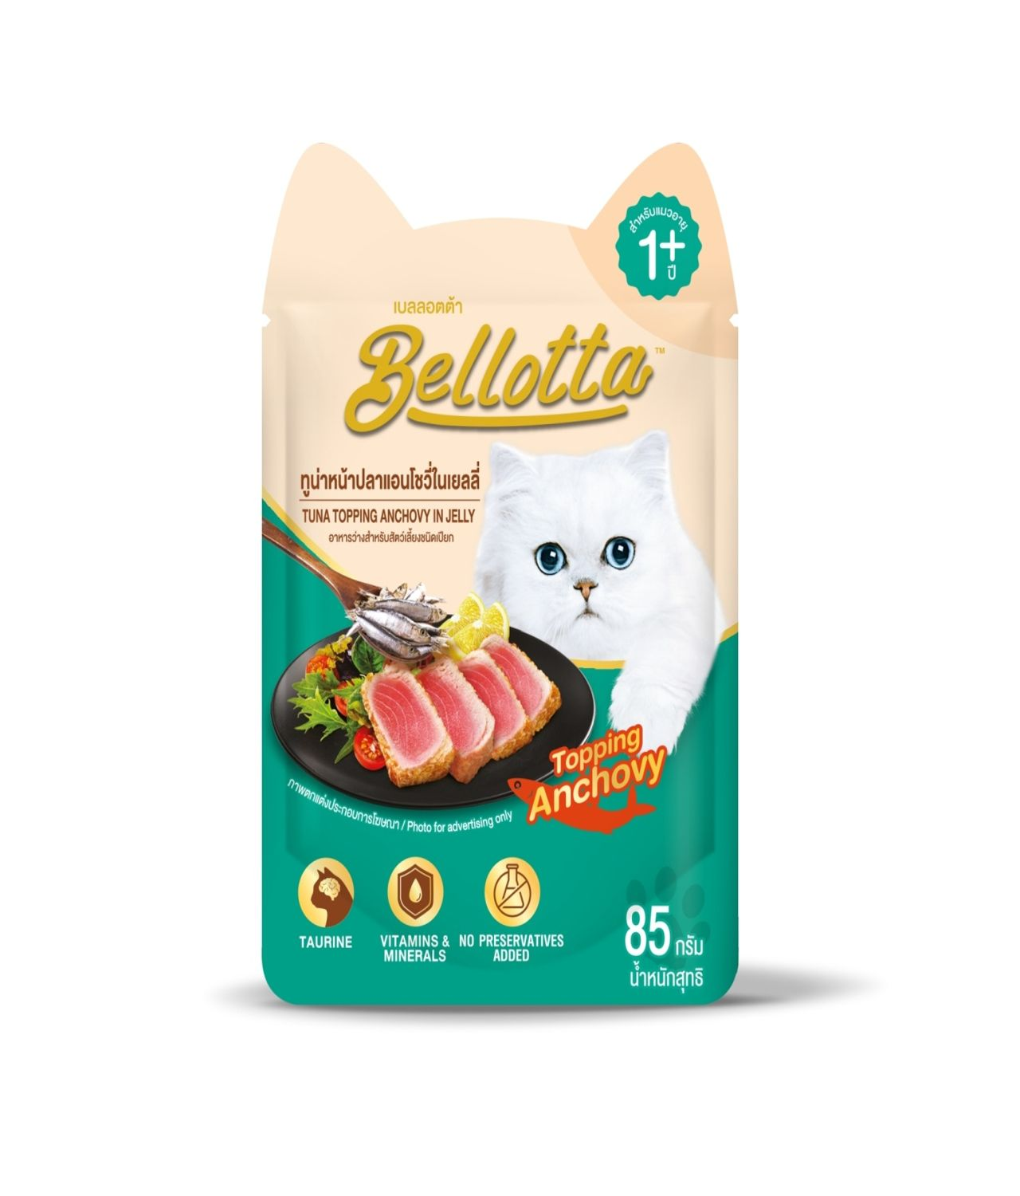


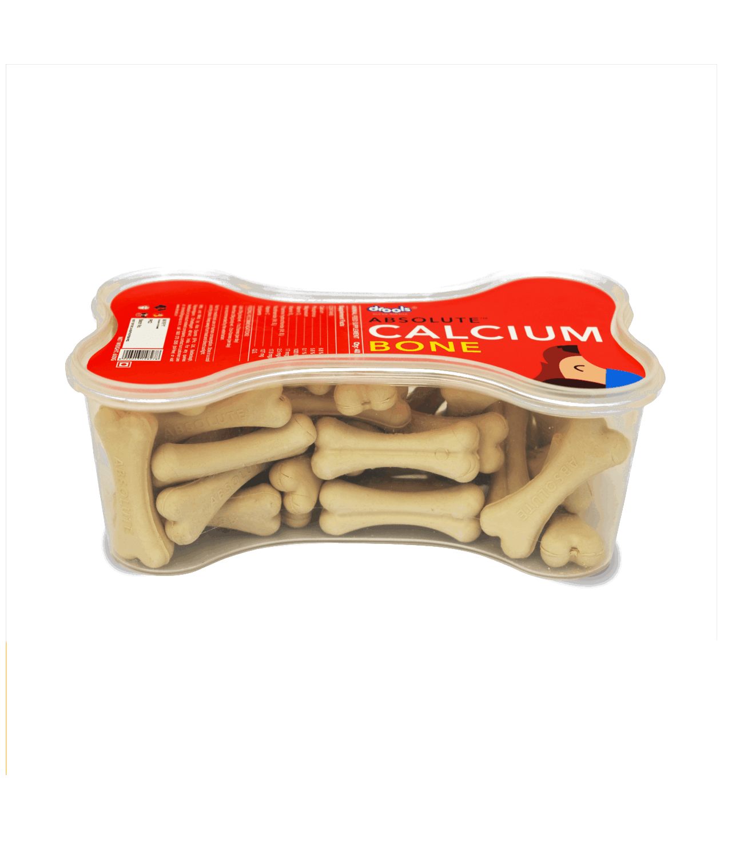
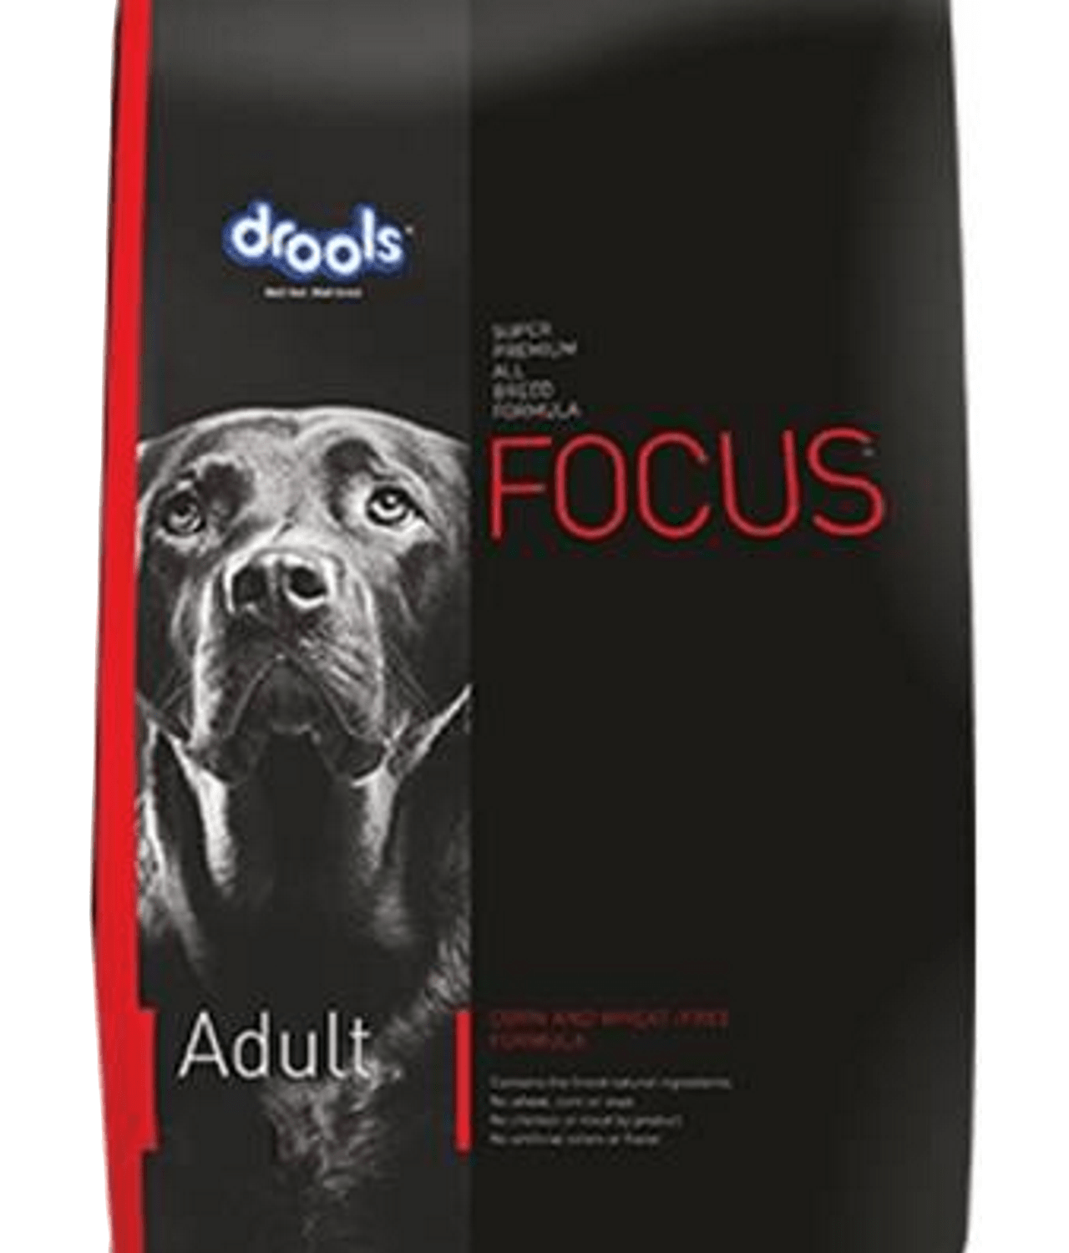
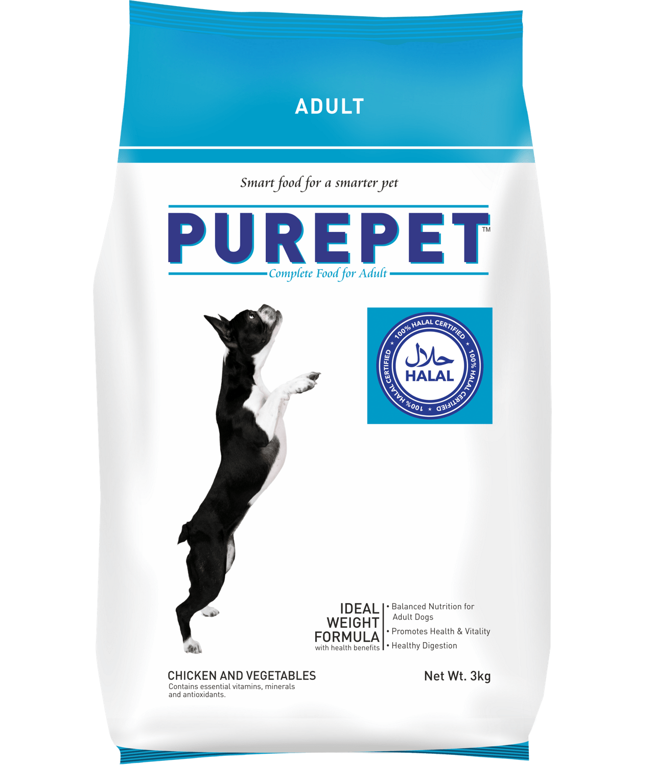
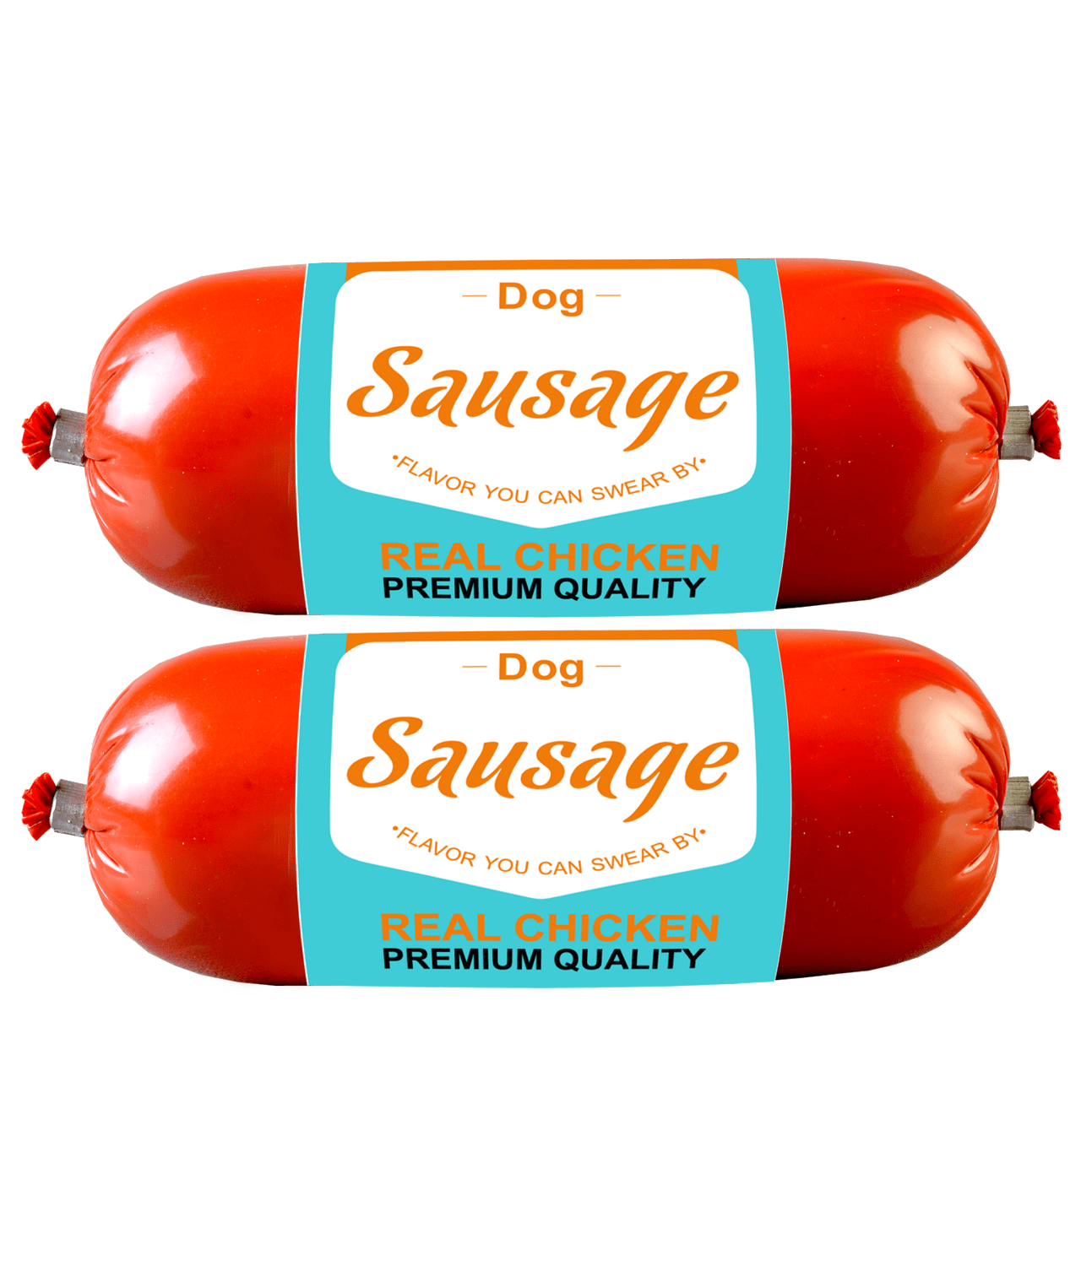
Delivery Charge Tk 40/- within Dhaka City.
Free Delivery within Dhaka City for Orders above Tk 1800/-
Search your product
My Account
Add to Cart
Helpline- 10360
Home
Shop
Service
About Us
Blog
Contact Us
Home/ Shop / Food
Food
Showing 1–8 of 20 results
1 2 3 4 …….. >
Filter by Price
Filter
Tk. 0 – Tk. 20,000
Premium Cat food (800g)
Tk 1350
SmartHeart Dog Food (20Kg)
Tk 6420
Mito Cat Food (Chicken- 1kg)
Tk 470
Bellotta Pouch Tuna (85gm)
Tk 75
Tk.0 – Tk. 4999
Tk.5000 – Tk. 9999
Tk.10000 – Tk. 14999
Tk.15000 – Tk. 20000
Add to Cart
Add to Cart
Add to Cart
Add to Cart
Drools Focus Dog Food (1kg)
Tk 1350
Purepet Dog Food Adult(20Kg)
Tk 15000
Drools Dog Calcium Bone
Tk 780
Drols Chicken Sausage For Dogs Tk 150
Add to Cart
Add to Cart
Add to Cart
Add to Cart

Slide 11


Delivery Charge Tk 40/- within Dhaka City.
Free Delivery within Dhaka City for Orders above Tk 1800/-
Search your product
My Account
Add to Cart
Helpline- 10360
Home
Shop
Service
About Us
Blog
Contact Us
Home/ Shop / Food / Premium Cat Food
Additional Information
Premium Cat Food by Drools (3Kg)
Weight | 3kg
Flavor | Dry, Ocean Fish
Ingredients | Copper, Corn gluten meal, Eggs, Iron, Manganese, Organic Minerals
Tk. 1350
20 Items in stock
1
Add to Cart
Description
Drools kitten ocean fish food is a complete and balanced feed for cats. Cats are fussy & choosy eaters and their nutritional requirements also very peculiar. It is formulated with real delicious high quality ocean fish; Drools ocean fish cat food delivers optimum protein and energy along with essential nutrients to keep your cat healthy and active.
It has omega 6 and 3 fatty acids help support skin &coat and immunity. Supplemented with prebiotics & probiotics, this cat food protects from hair ball formation & maintains digestive tract health.
Delivery Information
Standard Delivery (Within Dhaka) | Tk. 50
Express Delivery (Outside Dhaka) | Tk. 100
Special Delivery (Within Dhaka) | Tk. 200

Slide 12
Delivery Charge Tk 40/- within Dhaka City.
Free Delivery within Dhaka City for Orders above Tk 1800/-
Search your product
My Account
Add to Cart
Helpline- 10360
Home
Shop
Service
About Us
Blog
Contact Us
Food
Accessories
Medicine
Our Most Popular Products
Premium Cat Bed Foam Shape (Large)
Tk. 400 Tk. 380
Premium Cat food (800g)
Tk1400 Tk 1350
Helminticide-L Deworming Tablet (1 Strip)
Tk 100
SmartHeart Adult Dog Food Chicken And Egg (20Kg)
Tk 6420
Add to Cart
Add to Cart
Add to Cart
Add to Cart

Slide 13
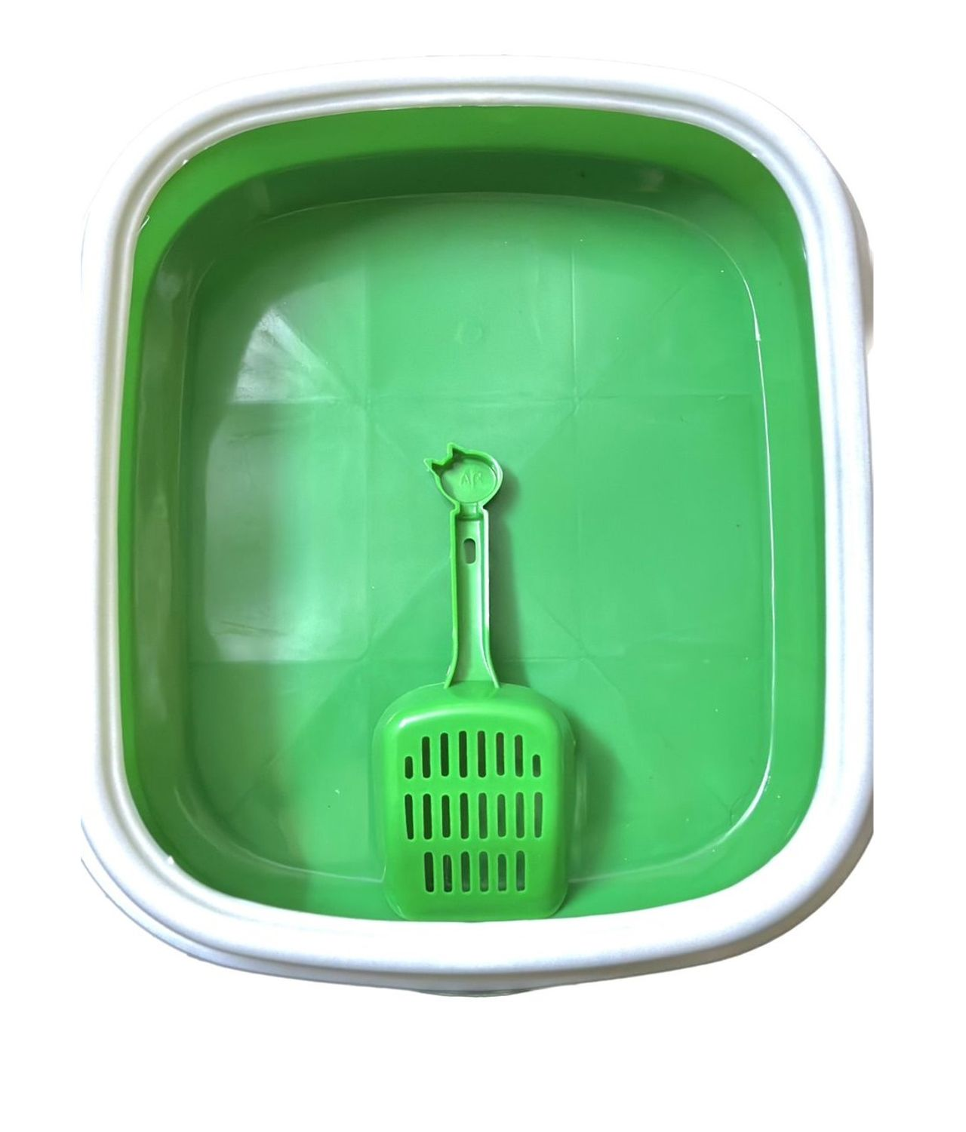

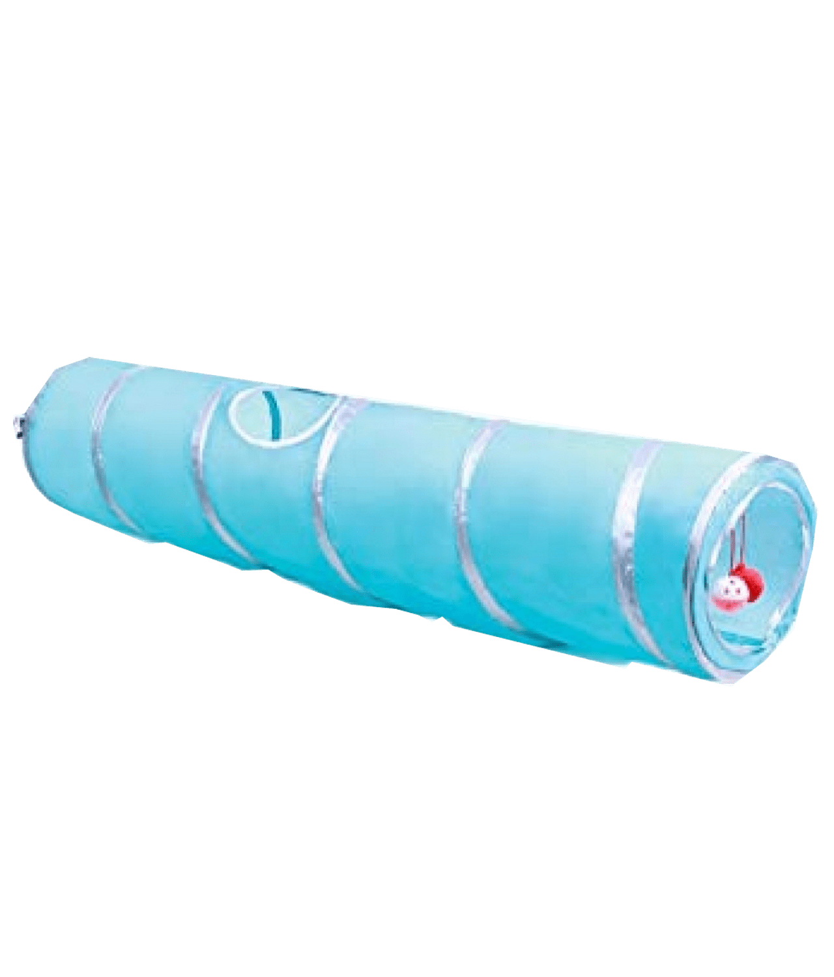
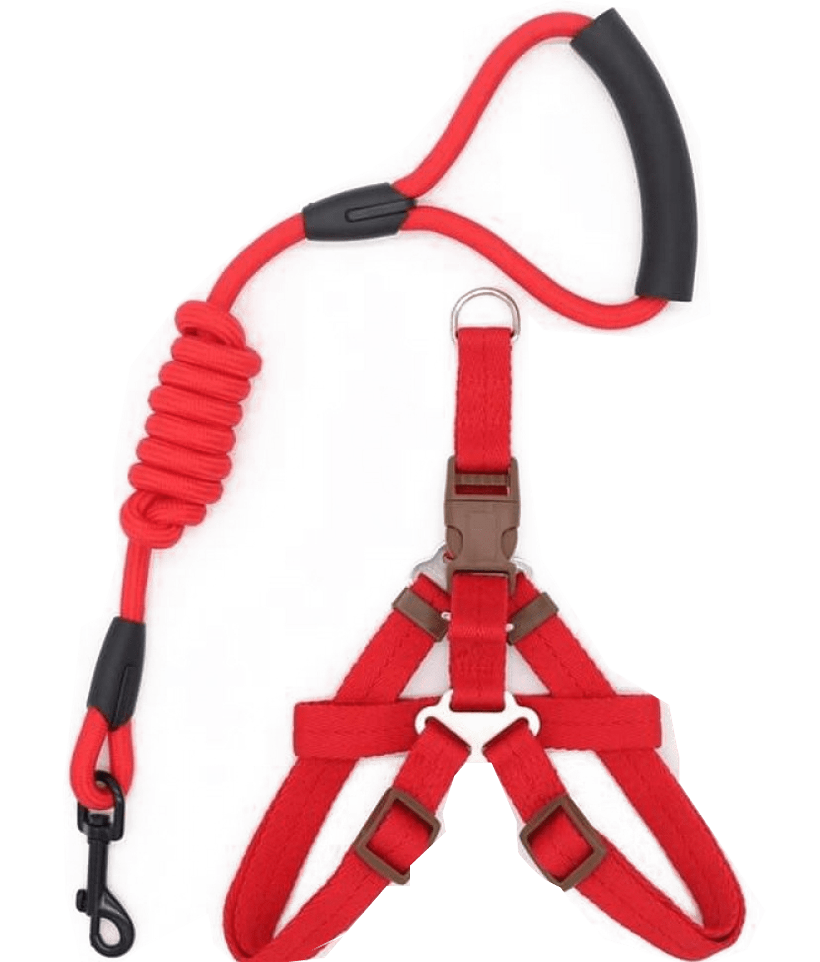
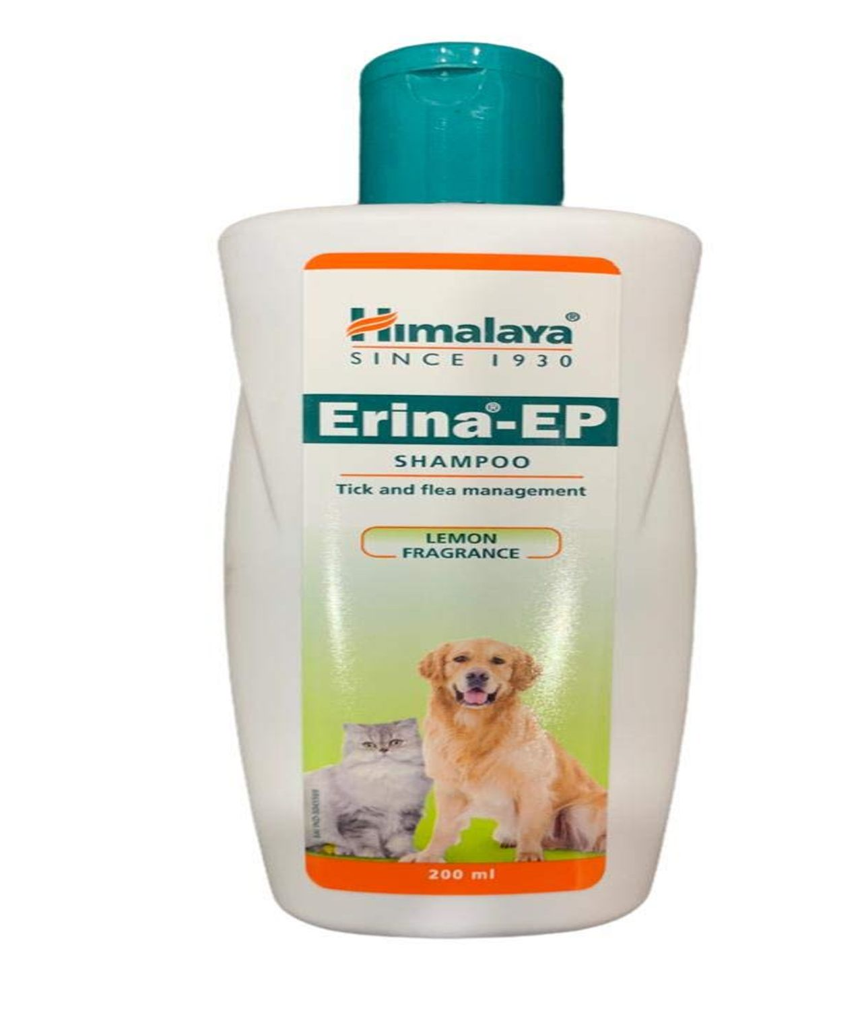
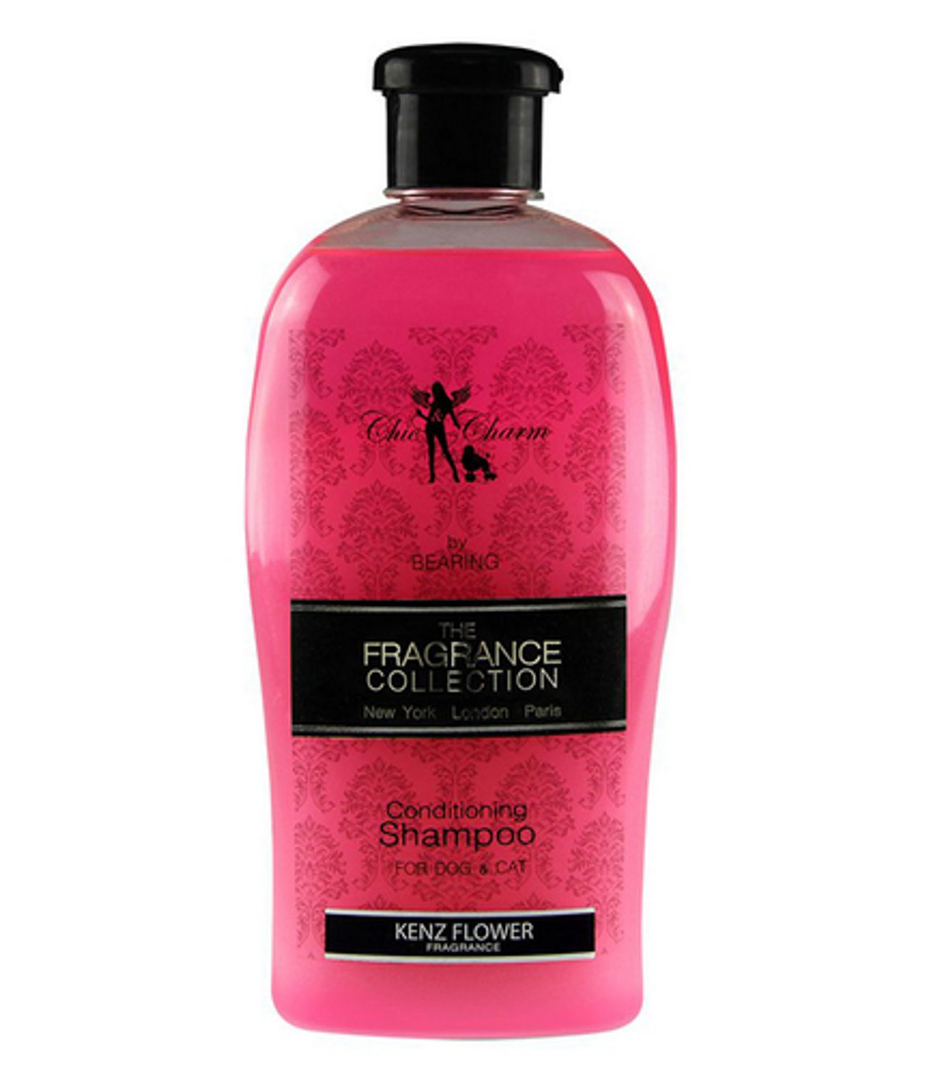
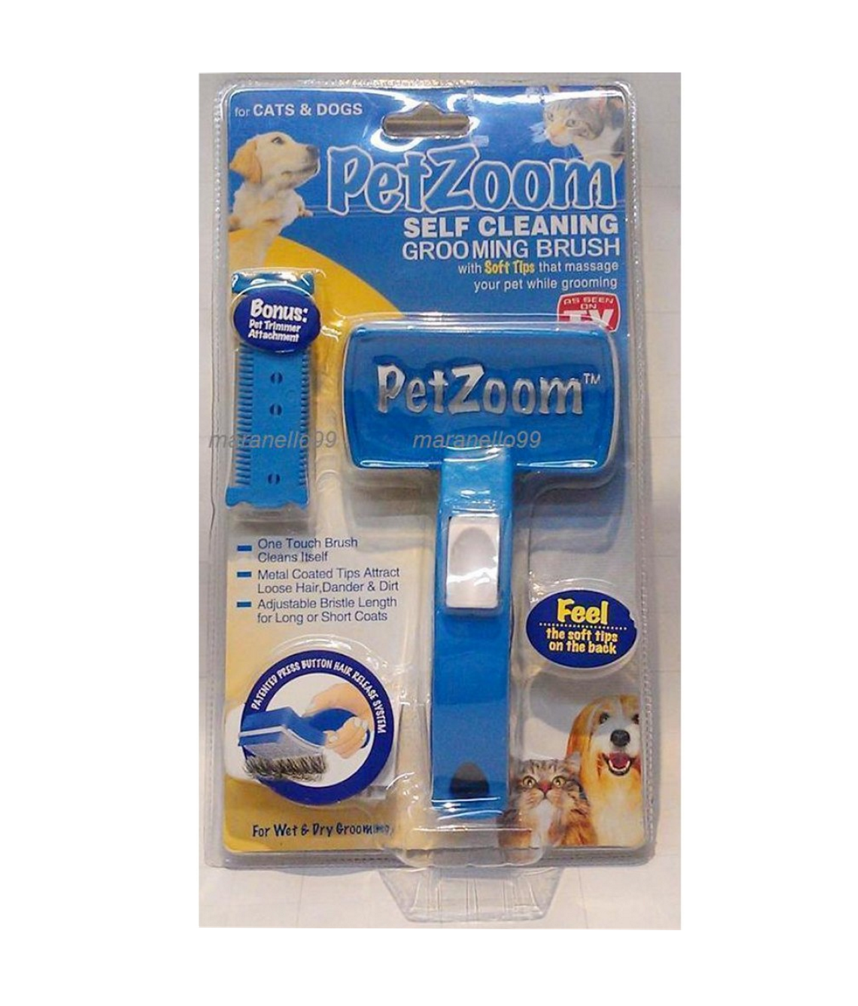
Delivery Charge Tk 40/- within Dhaka City.
Free Delivery within Dhaka City for Orders above Tk 1800/-
Search your product
My Account
Add to Cart
Helpline- 10360
Home
Shop
Service
About Us
Blog
Contact Us
Home/ Shop / Accessories
Accessories
Showing 1–8 of 20 results
1 2 3 4 …….. >
Filter by Price
Filter
Tk. 0 – Tk. 2000
Cat Litter Box With Scoop
Tk 600
Premium Cat Bed (Large)
Tk 380
Pet Toy Folding Breathable
Tk 1300
Premium Cat Collar With Bell Tk 100
Tk.0 – Tk. 499
Tk.500 – Tk. 999
Tk.1000 – Tk. 1499
Tk.1500 – Tk. 2000
Add to Cart
Add to Cart
Add to Cart
Add to Cart
Dog Harness Collar Leash
Tk 1000
Himalaya Erina Shampoo(200ml) Tk 590
Bearing Conditioning Shampoo(680ml)
Tk 1500
Pet Zoom Self Cleaning Brush Tk 510
Add to Cart
Add to Cart
Add to Cart
Add to Cart

Slide 14
Delivery Charge Tk 40/- within Dhaka City.
Free Delivery within Dhaka City for Orders above Tk 1800/-
Search your product
My Account
Add to Cart
Helpline- 10360
Home
Shop
Service
About Us
Blog
Contact Us
Home/ Shop / Accessories / Cat Litter Box (Green Color)
Additional Information
Cat Litter Box with Scoop (Green Color)
Length | 48 cm
Wide | 40 cm
Height | 13 cm
Tk. 600
2 Items in stock
1
Add to Cart
Description
A cat litter box is an indoor collection box for cats to urinate and defecate. It provides a contained and predetermined location for the cat's waste, allowing for easy cleanup by the pet owner.
Delivery Information
Standard Delivery (Within Dhaka) | Tk. 50
Express Delivery (Outside Dhaka) | Tk. 100
Special Delivery (Within Dhaka) | Tk. 200

Slide 15
Delivery Charge Tk 40/- within Dhaka City.
Free Delivery within Dhaka City for Orders above Tk 1800/-
Search your product
My Account
Add to Cart
Helpline- 10360
Home
Shop
Service
About Us
Blog
Contact Us
Food
Accessories
Medicine
Our Most Popular Products
Premium Cat Bed Foam Shape (Large)
Tk. 400 Tk. 380
Premium Cat food (800g)
Tk1400 Tk 1350
Helminticide-L Deworming Tablet (1 Strip)
Tk 100
SmartHeart Adult Dog Food Chicken And Egg (20Kg)
Tk 6420
Add to Cart
Add to Cart
Add to Cart
Add to Cart

Slide 16

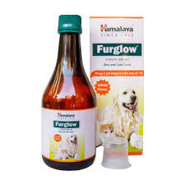

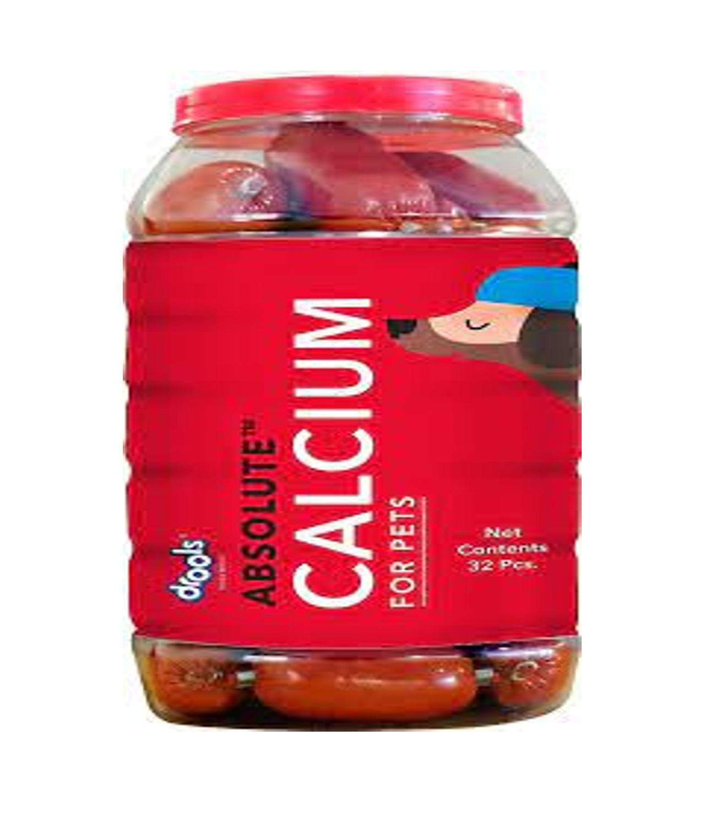
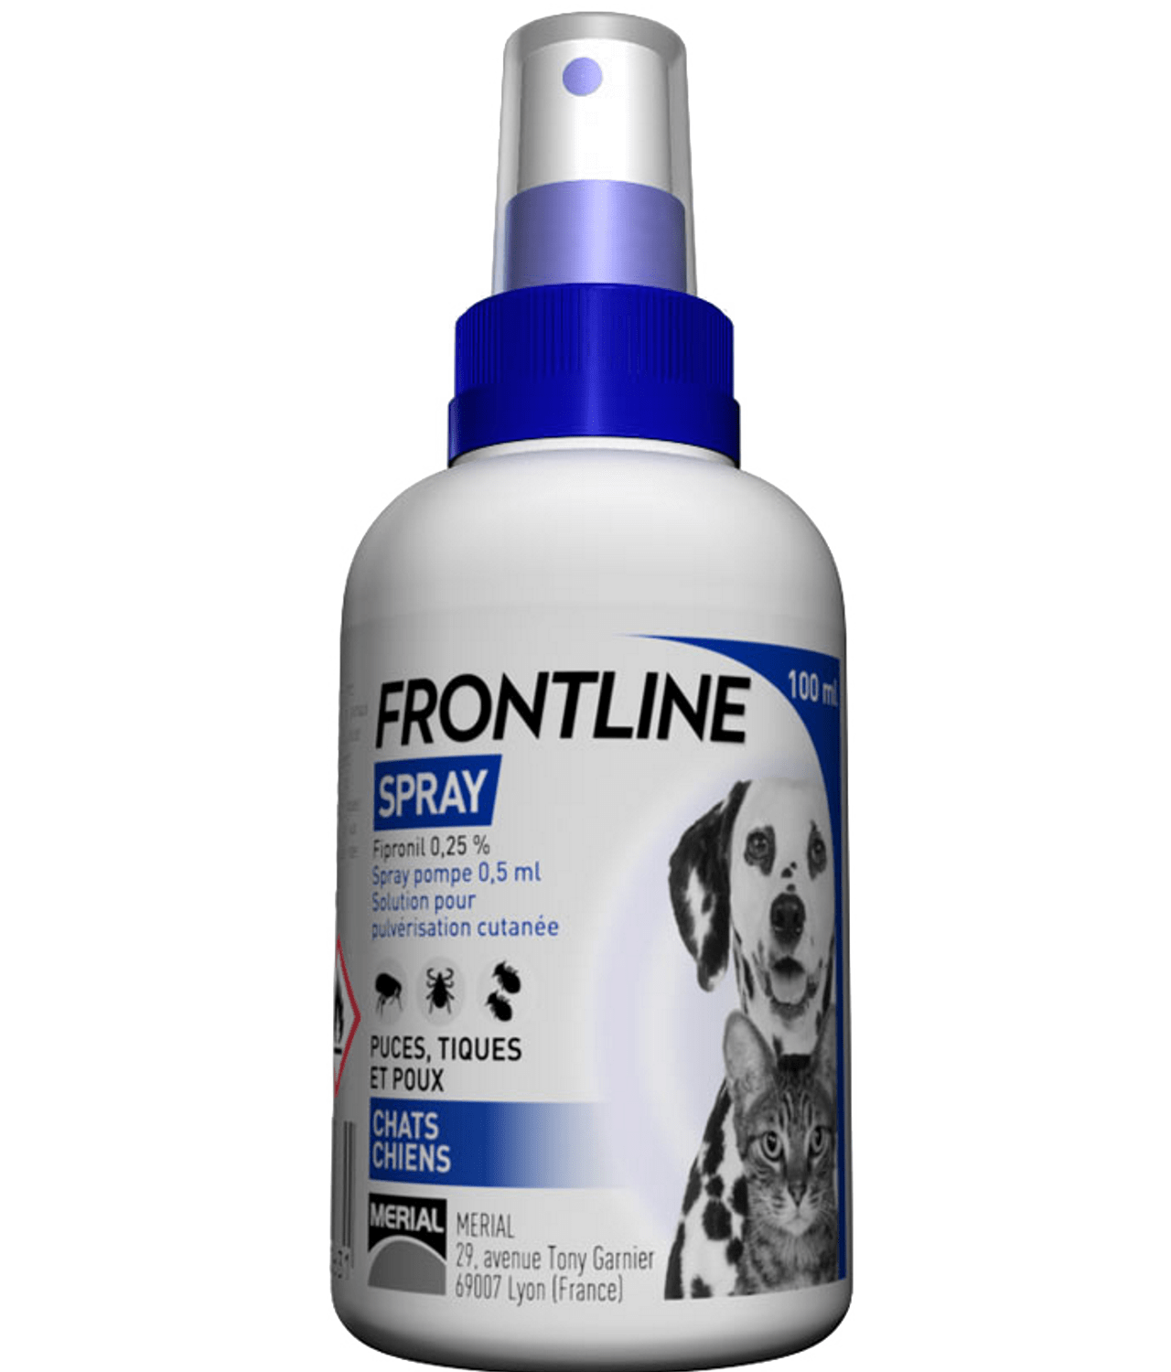
Delivery Charge Tk 40/- within Dhaka City.
Free Delivery within Dhaka City for Orders above Tk 1800/-
Search your product
My Account
Add to Cart
Helpline- 10360
Home
Shop
Service
About Us
Blog
Contact Us
Home/ Shop / Medicine
Medicine
Showing 1–6 of 16 results
1 2 3 …….. >
Filter by Price
Filter
Tk. 0 – Tk. 1500
Helminticide-L Tablet (1 Tablet)
Tk 60
Topicure Natural Spray-Topical Cure(100ml)
Tk 500
Himalaya Furglow Skin Tonic(400ml)
Tk 1300
Versele Laga Oropharma Cat Attract(200ml)
Tk 1500
Tk.0 – Tk. 499
Tk.500 – Tk. 999
Tk.1000 – Tk. 1500
Add to Cart
Add to Cart
Add to Cart
Add to Cart
Drools Absolute Calcium Sausage Dog Supplement Tk 1100
Frontline Spray (100ml) – Cats & Dogs
Tk 590
Add to Cart
Add to Cart

Slide 17
Delivery Charge Tk 40/- within Dhaka City.
Free Delivery within Dhaka City for Orders above Tk 1800/-
Search your product
My Account
Add to Cart
Helpline- 10360
Home
Shop
Service
About Us
Blog
Contact Us
Home/ Shop / Medicine / Cat Litter Box (Green Color)
Frontline Spray (100ml) – Cats & Dogs
Tk. 590
Delivery Information
6 Items in stock
Standard Delivery (Within Dhaka) | Tk. 50
Express Delivery (Outside Dhaka) | Tk. 100
Special Delivery (Within Dhaka) | Tk. 200
1
Add to Cart
Description
Flea and tick treatment spray-on topical flea control formula can be applied directly to pets to provide fast-acting control of fleas and ticks for up to 30 days
Spray bottle is easy to use, ensures fast and even application and can be reapplied regularly
Kills fleas before they lay eggs, effectively preventing reinfestation
Contains fiprinol to kill pests quickly and safely; safe for dogs, puppies, cats and kittens 8 weeks or older

Slide 18
Delivery Charge Tk 40/- within Dhaka City.
Free Delivery within Dhaka City for Orders above Tk 1800/-
Search your product
My Account
Add to Cart
Helpline- 10360
Home
Shop
Service
About Us
Blog
Contact Us
We Provide
Book an Appointment
Our Most Popular Products
Premium Cat Bed Foam Shape (Large)
Tk. 400 Tk. 380
Premium Cat food (800g)
Tk1400 Tk 1350
Helminticide-L Deworming Tablet (1 Strip)
Tk 100
SmartHeart Adult Dog Food Chicken And Egg (20Kg)
Tk 6420
Add to Cart
Add to Cart
Add to Cart
Add to Cart

Slide 19
Delivery Charge Tk 40/- within Dhaka City.
Free Delivery within Dhaka City for Orders above Tk 1800/-
Search your product
My Account
Add to Cart
Helpline- 10360
Home
Shop
Service
About Us
Blog
Contact Us
Gentle Touch
At The Pet Shop Animal Hospital, we prioritize your pet's health at every life stage. We recommend annual check-ups for young pets and semi-annual visits for cats and dogs over 7 to catch any health issues early. The Pet Shop Animal Hospital also offers Fear Free grooming, ensuring a stress-free experience tailored to your pet’s unique needs. Keep your pet happy, healthy, and well-groomed—schedule a wellness visit today!
About Our Services
Grooming Services We Provide
Our professional groomer has been grooming pets for a few years. The grooming services we provides include:
Bath and blowout
Specialty cuts
Ear cleaning
Anal gland expressions
Nail trims
Nail polish
Veterinary Services We Provide
Our professional veterinary has been vetting pets for a few years. The veterinary services we provides include:
Emergency Care
Dental Care
Microchipping
Surgery
Vaccinations
Ear Treatment

Slide 20
Delivery Charge Tk 40/- within Dhaka City.
Free Delivery within Dhaka City for Orders above Tk 1800/-
Search your product
My Account
Add to Cart
Helpline- 10360
Home
Shop
Service
About Us
Blog
Contact Us
We Provide
Book an Appointment
Our Most Popular Products
Premium Cat Bed Foam Shape (Large)
Tk. 400 Tk. 380
Premium Cat food (800g)
Tk1400 Tk 1350
Helminticide-L Deworming Tablet (1 Strip)
Tk 100
SmartHeart Adult Dog Food Chicken And Egg (20Kg)
Tk 6420
Add to Cart
Add to Cart
Add to Cart
Add to Cart

Slide 21
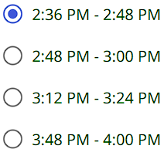
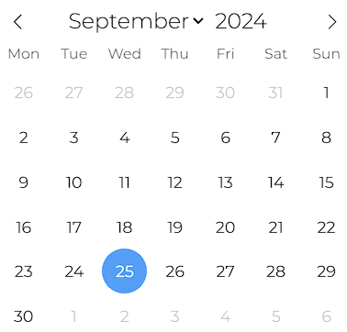
Delivery Charge Tk 40/- within Dhaka City.
Free Delivery within Dhaka City for Orders above Tk 1800/-
Search your product
My Account
Add to Cart
Helpline- 10360
Home
Shop
Service
About Us
Blog
Contact Us
Online Request Form
Select a service- Select prefer grooming service- Select date- Select time-
Select One
Select One
Select Date
Grooming
Bath & blowout
Veterinary
Specialty Cuts
Select pet type-
Ear Cleaning
Select One
Anti gland Expression
Cat
Nail Trims
Dog
Nail Polish
Submit

Slide 22
Delivery Charge Tk 40/- within Dhaka City.
Free Delivery within Dhaka City for Orders above Tk 1800/-
Search your product
My Account
Add to Cart
Helpline- 10360
Home
Shop
Service
About Us
Blog
Contact Us
Online Request Form
Select a service- Select prefer veterinary service- Select date- Select time-
Select One
Select One
Select Date
Grooming
Dental Care
Veterinary
Emergency Care
Select pet type-
Microchipping
Select One
Surgery
Cat
Ear Treatment
Dog
Vaccination
Submit

Slide 23
Delivery Charge Tk 40/- within Dhaka City.
Free Delivery within Dhaka City for Orders above Tk 1800/-
Search your product
My Account
Add to Cart
Helpline- 10360
Home
Shop
Service
About Us
Blog
Contact Us
About Us!!
At The Pet Shop, we offer everything your pet needs under one roof. From expert grooming sessions that ensure a stress-free, clean, and healthy experience, to comprehensive medical services that keep your pet in top health, we’ve got you covered. We also provide a wide selection of high-quality pet food and accessories to keep your furry friend happy and comfortable. At The Pet Shop, your pet’s well-being is our priority!

Slide 24

Delivery Charge Tk 40/- within Dhaka City.
Free Delivery within Dhaka City for Orders above Tk 1800/-
Search your product
My Account
Add to Cart
Helpline- 10360
Home
Shop
Service
About Us
Blog
Contact Us
Pet Care Blog
Read More
Read More
Read More

Slide 25
Delivery Charge Tk 40/- within Dhaka City.
Free Delivery within Dhaka City for Orders above Tk 1800/-
Search your product
My Account
Add to Cart
Helpline- 10360
Home
Shop
Service
About Us
Blog
Contact Us
If you have any questions or enquiries, please feel free to contact us.
Address- Block-A, House No-10, Banani, Dhaka.
Opening Hours
Monday to Friday: 8:00am – 6:00pm Saturdays: 8:00am – 12:00pm Sundays & Public Holidays: Closed
Contact Us
Call- 01785469821, 01987645812
Email- thepetshop@gmail.com
Follow us on Instagram- thepetshop_king

Slide 26

Supto Roy
Super Admin
Search
Dashboard
Select Date-
User Management
Homepage Management
Select Date
Employee Assign
Employee Status
Customer Status
Total Employee- 45
Groomer- 17
Veterinary - 20
Receptionist- 8
Total Customer- 1,00,050
Active Customer- 80,000
Deactivate Customer- 20,000
Appointment Taken Customer- 50

Slide 27




Supto Roy
Super Admin
User Management / Employee Assign
Search
User Management
Homepage Management
Name
Username
Password
Designation
Salary
Action
Employee Assign
Pritam Dey deypritam001 ********** Veterinary 15,000
Zian Ahmed ahmedzian002 ********** Groomer 10,000
Supriyo Paul paulsup003 ********** Receptionist 7,000
Sporsho Paul paulspor004 ********** Groomer 10,000
Shoudha Saha sahasho005 ********** Veterinary 15,000
1 2 3 …….. 5 >

Slide 28
Supto Roy
Super Admin
Search
Dashboard
Select Date-
User Management
Homepage Management
Select Date
Employee Assign
Employee Status
Customer Status
Total Employee- 45
Groomer- 17
Veterinary - 20
Receptionist- 8
Total Customer- 1,00,050
Active Customer- 80,000
Deactivate Customer- 20,000
Appointment Taken Customer- 50

Slide 29
Supto Roy
Super Admin
User Management / Employee Status
Search
User Management
Homepage Management
Name
Joining Date
Contact Number
Required Documents
Status
Action
Employee Status
Pritam Dey 05/03/2023 01865896314 Certificates
Zian Ahmed 10/09/2022 01985247862 NID
Supriyo Paul 01/05/2023 01785496314 NID, Certificates
Sporsho Paul 02/01/2022 01685498741 Certificates
Shoudha Saha 07/08/2023 01785469856 NID
Submitted
Not Submitted
Submitted
Submitted
Not Submitted
1 2 3 …….. 5 >

Slide 30
Supto Roy
Super Admin
Search
Dashboard
Select Date-
User Management
Homepage Management
Select Date
Employee Assign
Employee Status
Customer Status
Total Employee- 45
Groomer- 17
Veterinary - 20
Receptionist- 8
Total Customer- 1,00,050
Active Customer- 80,000
Deactivate Customer- 20,000
Appointment Taken Customer- 50

Slide 31
Supto Roy
Super Admin
User Management / Customer Status
Search
User Management
Homepage Management
Name
Username
Contact Number
Address
Action
Name
Username
Email
Action
Customer Status
Aditya Das dasadittya001 01785946975 Bashundhara, Dhaka
Ashik Khan khanashik002 01985247862 Banani, Dhaka
Safatul Alam alamsafatul003 01785496314 Niketon, Dhaka
Urme lubna urlubna004 01685498741 Uttara, Dhaka
Omi Sen senomi005 01785469856 Santosh, Tangail
1 2 3 …….. 5 >

Slide 32
Supto Roy
Super Admin
Search
Dashboard
Select Date-
User Management
Homepage Management
Select Date
Homepage
About us
Contact Us
Contact Us
Total Employee- 45
Groomer- 17
Veterinary - 20
Receptionist- 8
Total Customer- 1,00,050
Active Customer- 80,000
Deactivate Customer- 20,000
Appointment Taken Customer- 50

Slide 33

Supto Roy
Super Admin
Home Page Management / Homepage
Search
User Management
Homepage Management
Name
Title
Joining Date
Contact Number
Action
Required Documents
Status
Status
Action
Picture
Product Name
Price
Offer
Active
Homepage
Active
Deactivate
Active

Slide 34
Supto Roy
Super Admin
Search
Dashboard
Select Date-
User Management
Homepage Management
Select Date
Homepage
About us
Contact Us
Contact Us
Total Employee- 45
Groomer- 17
Veterinary - 20
Receptionist- 8
Total Customer- 1,00,050
Active Customer- 80,000
Deactivate Customer- 20,000
Appointment Taken Customer- 50

Slide 35
Supto Roy
Super Admin
Home Page Management / About us
Search
User Management
Homepage Management
Name
Title
Joining Date
Contact Number
Action
Required Documents
Status
Status
Action
Picture
Description
Video
Deactivate
About us
Active
Deactivate

Slide 36
Supto Roy
Super Admin
Search
Dashboard
Select Date-
User Management
Homepage Management
Select Date
Homepage
About us
Contact Us
Total Employee- 45
Groomer- 17
Veterinary - 20
Receptionist- 8
Total Customer- 1,00,050
Active Customer- 80,000
Deactivate Customer- 20,000
Appointment Taken Customer- 50

Slide 37
Supto Roy
Super Admin
Home Page Management / Contact Us
Search
User Management
Homepage Management
Name
Title
Joining Date
Contact Number
Action
Required Documents
Status
Status
Action
Picture
Description
Video
General Information
Deactivate
Contact Us
Active
Deactivate
Active

Slide 38
Rajesh Paul
HR
Search
Dashboard
Select Date-
User Management
Homepage Management
Select Date
Employee Assign
Employee Status
Customer Status
Total Employee- 45
Groomer- 17
Veterinary - 20
Receptionist- 8
Total Customer- 1,00,050
Active Customer- 80,000
Deactivate Customer- 20,000
Appointment Taken Customer- 50

Slide 39
Rajesh Paul
HR
User Management / Employee Assign
Search
User Management
Homepage Management
Name
Username
Password
Designation
Salary
Action
Employee Assign
Pritam Dey deypritam001 ********** Veterinary 15,000
Zian Ahmed ahmedzian002 ********** Groomer 10,000
Supriyo Paul paulsup003 ********** Receptionist 7,000
Sporsho Paul paulspor004 ********** Groomer 10,000
Shoudha Saha sahasho005 ********** Veterinary 15,000
1 2 3 …….. 5 >

Slide 40
Rajesh Paul
HR
Search
Dashboard
Select Date-
User Management
Homepage Management
Select Date
Employee Assign
Employee Status
Customer Status
Total Employee- 45
Groomer- 17
Veterinary - 20
Receptionist- 8
Total Customer- 1,00,050
Active Customer- 80,000
Deactivate Customer- 20,000
Appointment Taken Customer- 50

Slide 41
Rajesh Paul
HR
User Management / Employee Status
Search
User Management
Homepage Management
Name
Joining Date
Contact Number
Required Documents
Status
Action
Employee Status
Pritam Dey 05/03/2023 01865896314 Certificates
Zian Ahmed 10/09/2022 01985247862 NID
Supriyo Paul 01/05/2023 01785496314 NID, Certificates
Sporsho Paul 02/01/2022 01685498741 Certificates
Shoudha Saha 07/08/2023 01785469856 NID
Submitted
Not Submitted
Submitted
Submitted
Not Submitted
1 2 3 …….. 5 >

Slide 42
Rajesh Paul
HR
Search
Dashboard
Select Date-
User Management
Homepage Management
Select Date
Employee Assign
Employee Status
Customer Status
Total Employee- 45
Groomer- 17
Veterinary - 20
Receptionist- 8
Total Customer- 1,00,050
Active Customer- 80,000
Deactivate Customer- 20,000
Appointment Taken Customer- 50

Slide 43
Rajesh Paul
HR
User Management / Customer Status
Search
User Management
Homepage Management
Name
Username
Contact Number
Address
Action
Name
Username
Email
Action
Customer Status
Aditya Das dasadittya001 01785946975 Bashundhara, Dhaka
Ashik Khan khanashik002 01985247862 Banani, Dhaka
Safatul Alam alamsafatul003 01785496314 Niketon, Dhaka
Urme lubna urlubna004 01685498741 Uttara, Dhaka
Omi Sen senomi005 01785469856 Santosh, Tangail
1 2 3 …….. 5 >

Slide 44
Rajesh Paul
HR
Search
Dashboard
Select Date-
User Management
Homepage Management
Select Date
Homepage
About us
Contact Us
Blog
Total Employee- 45
Groomer- 17
Veterinary - 20
Receptionist- 8
Total Customer- 1,00,050
Active Customer- 80,000
Deactivate Customer- 20,000
Appointment Taken Customer- 50

Slide 45
Rajesh Paul
HR
Home Page Management / Homepage
Search
User Management
Homepage Management
Name
Title
Joining Date
Contact Number
Action
Required Documents
Status
Status
Action
Picture
Product Name
Price
Offer
Active
Homepage
Active
Deactivate
Active

Slide 46
Rajesh Paul
HR
Search
Dashboard
Select Date-
User Management
Homepage Management
Select Date
Homepage
About us
Contact Us
Blog
Total Employee- 45
Groomer- 17
Veterinary - 20
Receptionist- 8
Total Customer- 1,00,050
Active Customer- 80,000
Deactivate Customer- 20,000
Appointment Taken Customer- 50

Slide 47
Rajesh Paul
HR
Home Page Management / About us
Search
User Management
Homepage Management
Name
Title
Joining Date
Contact Number
Action
Required Documents
Status
Status
Action
Picture
Description
Video
Deactivate
About us
Active
Deactivate

Slide 48
Rajesh Paul
HR
Search
Dashboard
Select Date-
User Management
Homepage Management
Select Date
Homepage
About us
Contact Us
Blog
Total Employee- 45
Groomer- 17
Veterinary - 20
Receptionist- 8
Total Customer- 1,00,050
Active Customer- 80,000
Deactivate Customer- 20,000
Appointment Taken Customer- 50

Slide 49
Rajesh Paul
HR
Home Page Management / Contact Us
Search
User Management
Homepage Management
Name
Title
Joining Date
Contact Number
Action
Required Documents
Status
Status
Action
Picture
Description
Video
General Information
Deactivate
Contact Us
Active
Deactivate
Active

Slide 50
Rajesh Paul
HR
Search
Dashboard
Select Date-
User Management
Homepage Management
Select Date
Homepage
About us
Contact Us
Blog
Total Employee- 45
Groomer- 17
Veterinary - 20
Receptionist- 8
Total Customer- 1,00,050
Active Customer- 80,000
Deactivate Customer- 20,000
Appointment Taken Customer- 50

Slide 51
Rajesh Paul
HR
Home Page Management / Contact Us
Search
User Management
Homepage Management
Name
Title
Joining Date
Contact Number
Action
Required Documents
Status
Status
Action
Picture
Description
Video
General Information
Deactivate
Blog
Active
Deactivate
Active

Slide 52
Yagami
Receptionist
Dashboard
Select Date-
Select Date
Inventory Management
Appointment Management
Name
Joining Date
Contact Number
Action
Required Documents
Status
Action
General Information
Inventory Management
Total Products- 650
Total Food Items- 300
Total Accessories- 150
Total Medicine Items- 200
Request For Appointments- 70
Confirm Appointments- 50
Available Groomer-10
Available Veterinary-15

Slide 53
Yagami
Receptionist
Inventory Management / General Information
Inventory Management
Appointment Management
Name
Title
Joining Date
Contact Number
Action
Required Documents
Status
Status
Action
Product Name
Product Quantity
Picture
Price
Description
Additional Information
Delivery Information
Uploaded
General Information
Uploaded
Uploaded
Uploaded
Uploaded
Not Uploaded
Uploaded

Slide 54
Yagami
Receptionist
Dashboard
Select Date-
Select Date
Inventory Management
Appointment Management
Name
Joining Date
Contact Number
Action
Required Documents
Status
Action
General Information
Inventory Management
Total Products- 650
Total Food Items- 300
Total Accessories- 150
Total Medicine Items- 200
Request For Appointments- 70
Confirm Appointments- 50
Available Groomer-10
Available Veterinary-15

Slide 55
Yagami
Receptionist
Inventory Management / Inventory Management
Inventory Management
Appointment Management
Name
Joining Date
Contact Number
Required Documents
Status
Action
Name
Quantity
Price
Inventory Management
Premium Cat Foot (800g) | 20 | 1350
SmartHeart Dog Food (20kg) | 30 | 6420
Cat Litter Box | 2 | 600
Premium Cat Bed (Large) | 10 | 380
Dog Harness Collar Leash | 35 | 1000
Frontline Spray (Cats&Dogs) | 15 | 590
Himalaya Skin Tonic (400 ml) | 18 | 1300
1 2 3 …….. 5 >

Slide 56
Yagami
Receptionist
Dashboard
Select Date-
Select Date
Inventory Management
Appointment Management
Name
Joining Date
Contact Number
Action
Required Documents
Status
Action
Total Products- 650
Total Food Items- 300
Total Accessories- 150
Total Medicine Items- 200
Request For Appointments- 70
Confirm Appointments- 50
Available Groomer-10
Available Veterinary-15

Slide 57
Yagami
Receptionist
Appointment Management
Inventory Management
Appointment Management
Name
Contact Number
Required Documents
Status
Action
Name
Contact Number
Service
Pet Type
PreferedService
Date
Time
Name
Quantity
Price
Aditya Das | 01765896314 | Grooming | Dog | Bath & blowout | 25/09/2024 | 2:36 PM – 2:48 PM
Ashik Khan | 01985247865 | Veterinary | Cat | Dental Care | 25/09/2024 | 2:48 PM – 3:00 PM
Safatul Alam | 01785496314 | Veterinary | Dog | Ear Treatment | 26/09/2024 | 2:36 PM – 2:48 PM
Omi Sen | 01785469856 | Grooming | Cat | Nail Trims | 27/06/2024 | 11:30 AM- 11:40 AM
1 2 3 …….. 5 >

Slide 58
Ratul Paul
Groomer
Dashboard
Select Date-
Select Date
Today’s Schedule
You have a grooming session with Mr. Aditya Das (01765896314) at 2:36 PM
You have a grooming session with Mr. Omi Sen (01785469856) at 3:00 PM
You have a grooming session with Mr. Zian Ahmed (01865896134) at 3:30 PM
You have a grooming session with Mr. Nobin Saha (01766896854) at 4:00 PM
You have a grooming session with Mr. Samiul Hasib (01865828699) at 4:30 PM
You have a grooming session with Mrs. Sajida Khatun (01765896314) at 5:00 PM

Slide 59
Ratul Paul
Groomer
Dashboard
Select Date-
25-09-2024
Today’s Schedule
You have a grooming session with Mr. Aditya Das (01765896314) at 2:36 PM
You have a grooming session with Mr. Omi Sen (01785469856) at 3:00 PM
You have a grooming session with Mr. Zian Ahmed (01865896134) at 3:30 PM
You have a grooming session with Mr. Nobin Saha (01766896854) at 4:00 PM
You have a grooming session with Mr. Samiul Hasib (01865828699) at 4:30 PM
You have a grooming session with Mrs. Sajida Khatun (01765896314) at 5:00 PM

Slide 60
Mehrab Efti
Veterinary
Dashboard
Select Date-
Select Date
Today’s Schedule
You have a veterinary session with Mr. Aditya Das (01765896314) at 11:00 AM
You have a veterinary session with Mr. Omi Sen (01785469856) at 11:30 AM
You have a veterinary session with Mr. Zian Ahmed (01865896134) at 12:30 PM
You have a veterinary session with Mr. Nobin Saha (01766896854) at 1:00 PM
You have a veterinary session with Mr. Samiul Hasib (01865828699) at 2:30 PM
You have a veterinary session with Mrs. Sajida Khatun (01765896314) at 3:00 PM

Slide 61
Mehrab Efti
Veterinary
Dashboard
Select Date-
21-09-2024
Today’s Schedule
You have a veterinary session with Mr. Aditya Das (01765896314) at 11:00 AM
You have a veterinary session with Mr. Omi Sen (01785469856) at 11:30 AM
You have a veterinary session with Mr. Zian Ahmed (01865896134) at 12:30 PM
You have a veterinary session with Mr. Nobin Saha (01766896854) at 1:00 PM
You have a veterinary session with Mr. Samiul Hasib (01865828699) at 2:30 PM
You have a veterinary session with Mrs. Sajida Khatun (01765896314) at 3:00 PM

